Slide 2
Unlocking Fusion with Containers and Kubernetes
T6983
Jason Poon
Senior Software Developer
Microsoft
Jonathan Fraser
Software Architect
General Fusion

Slide 3
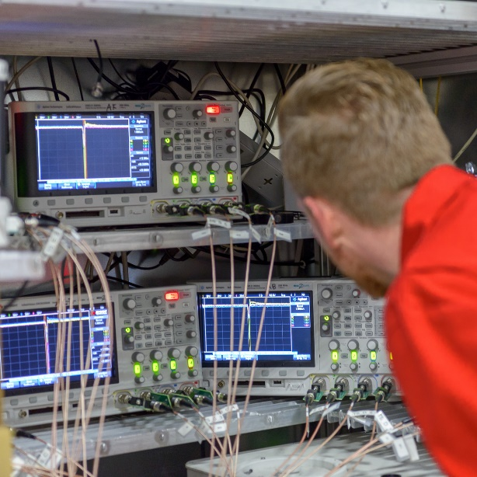
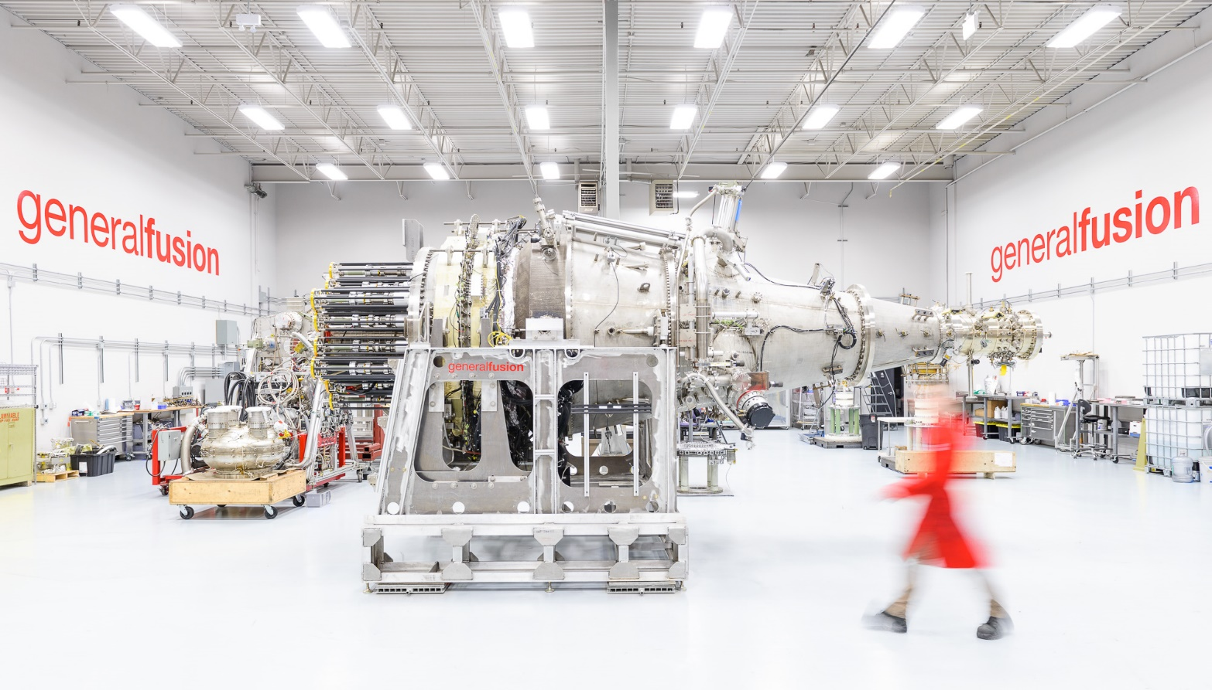
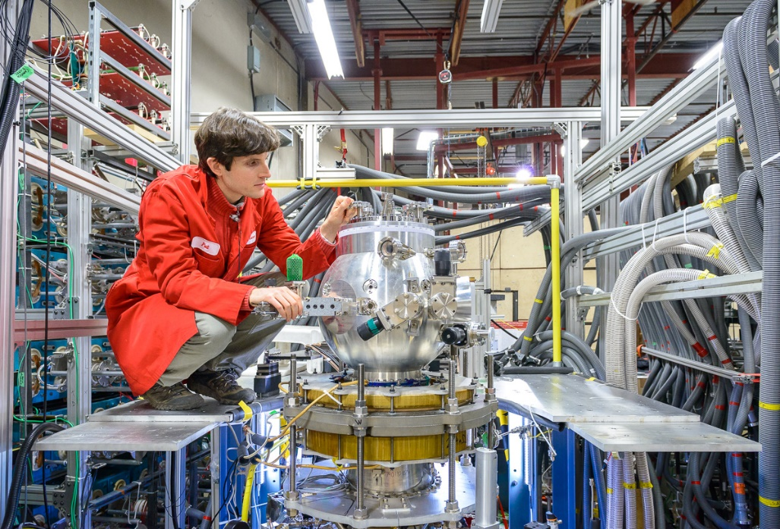
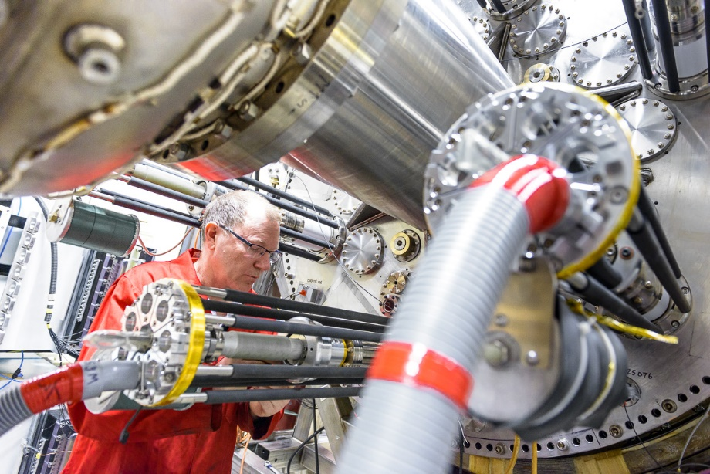
Notes:
Developing a fusion power plant
Based in Burnaby, BC
Started in 2002
65 employees
~50 scientists & engineers
Raised over $100 million
Injectors above me

Slide 4



Experimental Data Management
CHALLENGES:
Sensor
Data
Calibration
Data
1
Disparate Language and Tools
2
Job Scheduling
Processing
Code
Data Provenance
3
Collaboration
4
Physics
Data
Notes:
Elaborating on the challenges. Why this is hard?
Disparate Language and Tools
Python, MATLAB, Scientific Codes (Fortran, C), et al.
Job Scheduling
Manage resources, detect changes
Provenance of Data
Track how results were calculated
Collaboration
Distribute data and history

Slide 5



Demo
Sensor
Data
Calibration
Data
Scale
Scaled
Data
Average
Averaged
Data

Slide 6
Call to Action
Resources:
Reproducible Data Science Code Story: www.microsoft.com/reallifecode/2017/04/12/reproducible-data-science-analysis-experimental-data-pachyderm-azure/
General Fusion: www.generalfusion.com
Azure Container Service: azure.microsoft.com/services/container-service
Kubernetes: http://kubernetes.io
Pachyderm: http://pachyderm.io
Demo: https://github.com/jpoon/generalfusion
Re-visit Build session recordings on Channel 9.
#MSBuild

Slide 7
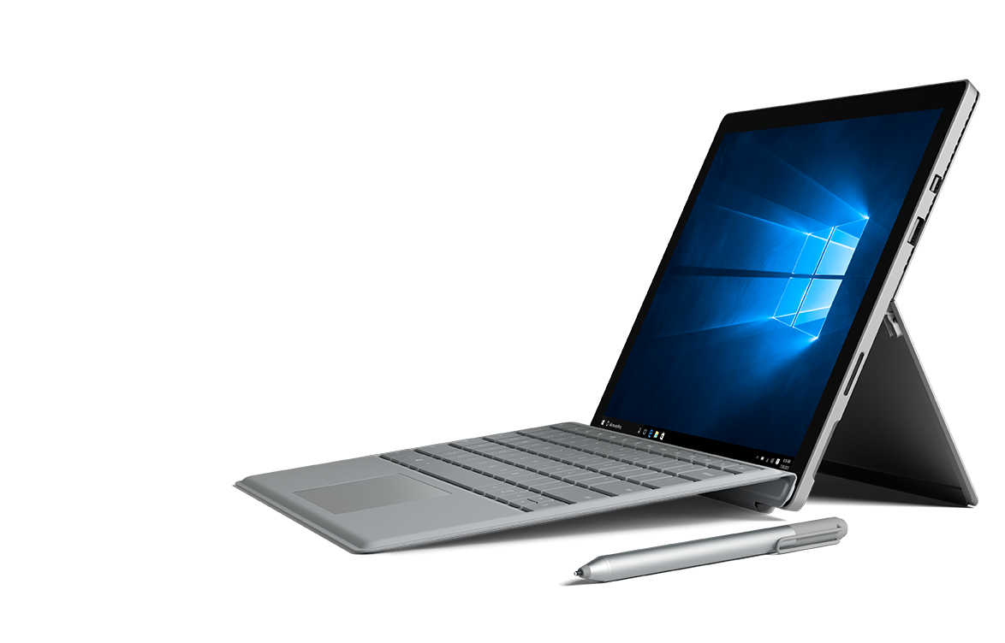
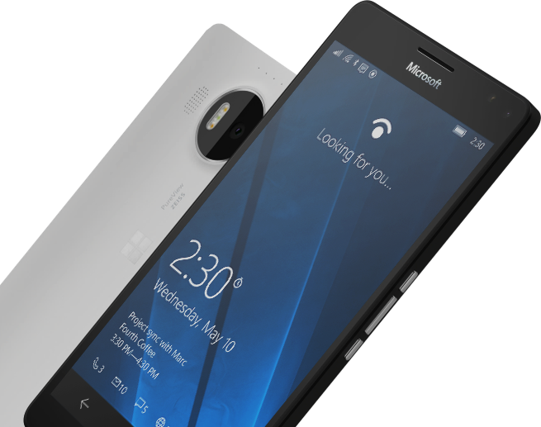
Please Complete An Evaluation Form for every session you attend.
Your input is important!
#MSBuild

Slide 9
ATTENTION: PLEASE READ
Photography and copyright infringement.
Due to copyright laws, please refrain from searching for photography online and utilizing them in your presentations. Using imagery from movies, television, music and pop-culture is illegal, unless purchased from a stock photography site or given expressed written consent from the owner. If you have any questions regarding your imagery please consult with CELA and/or read more at this site.
Alternatively, please see the photography section below for instruction on impactful photo usage and links to Microsoft owned images.
Please also consider brand illustrations. See the illustration slides
for details. Custom illustrations created by
Silver Fox Productions are also available.

Slide 10
Common Copyright Myths
If an image is on the Internet/Bing it is in the public domain.
If there is no copyright notice on the image, I don’t need permission.
If I don’t profit from the use, I don’t need permission.
If I remove the image after notice, I don’t owe any money to the copyright.
If I alter the image X%, I don’t need permission.
If I only use a part of the image, I don’t need permission.
If I only include a hyperlink in my presentation and click it to show the image, I don’t need permission.
Notes:
Red on black is hard to read.

Slide 11
Related sessions
Provide a list of related sessions for attendees:
Related breakout sessions
Related theater sessions
Hub demo stations, etc.
#MSBuild

Slide 12
Text layout (without bullet points)
Main topic 1: size 36pt
Size 28pt for second level
Size 24pt for third level
Size 22pt for fourth level
Size 22 for fifth level

Slide 13
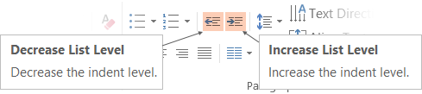
Adjusting list levels
Main topic 1: size 36pt
Size 28pt for second level
Size 24pt for third level
Size 22pt for fourth level
Size 22 for fifth level
Use the “Decrease List Level” and “Increase List Level” tools on the Home Menu to change text levels.
Try this:
Place your cursor in any row of text to the left that says “Size 20pt for subtopics”
Next click the Home tab, and then on the “Decrease List level” tool. Notice how the line moves up one level.
Now try placing your cursor in one of the “Main topic…” lines of text. Click the “Increase List Level” tool and see how the text is pushed in one level
Use these 2 tools to adjust your text levels as you work

Slide 14
Bullet points layout with subtitle Subtitle is smaller in the same text block
Example of a bulleted slide with a subhead
Set the slide title to “Sentence case”
Set subheads to “Sentence case”
Hyperlink style
www.microsoft.com

Slide 15
Photo layout 1

Slide 16
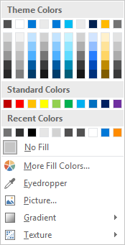
Slide palette info
The PowerPoint palette for this template has been built for you and is shown below. Avoid using too many colors in your presentation.
Accent colors 1-6 – (6 Theme Colors to the far right)
Accent 1
Accent 2
Accent 3
Accent 4
Accent 5
Accent 6
Use Accent 1 as the main accent color. Use Accent 2 and Accent 3 when additional colors are needed.
Use Accents 4-6 sparingly – only when more colors are necessary.

Slide 17
Video

Slide 18
Section title

Slide 19
Slide for developer code and Github URLs
This slide layout uses Consolas, a monotype font which is ideal for showing software code.
Also, provide info that gives attendees some specifics about what they will find when they look at your Github code.

Slide 20
Notes (hidden)
Some speakers at Microsoft like to use this slide for hidden “notes slides”.
Delete it if you don’t want to use it.
NEXT: <next slide title>

